Slide 1
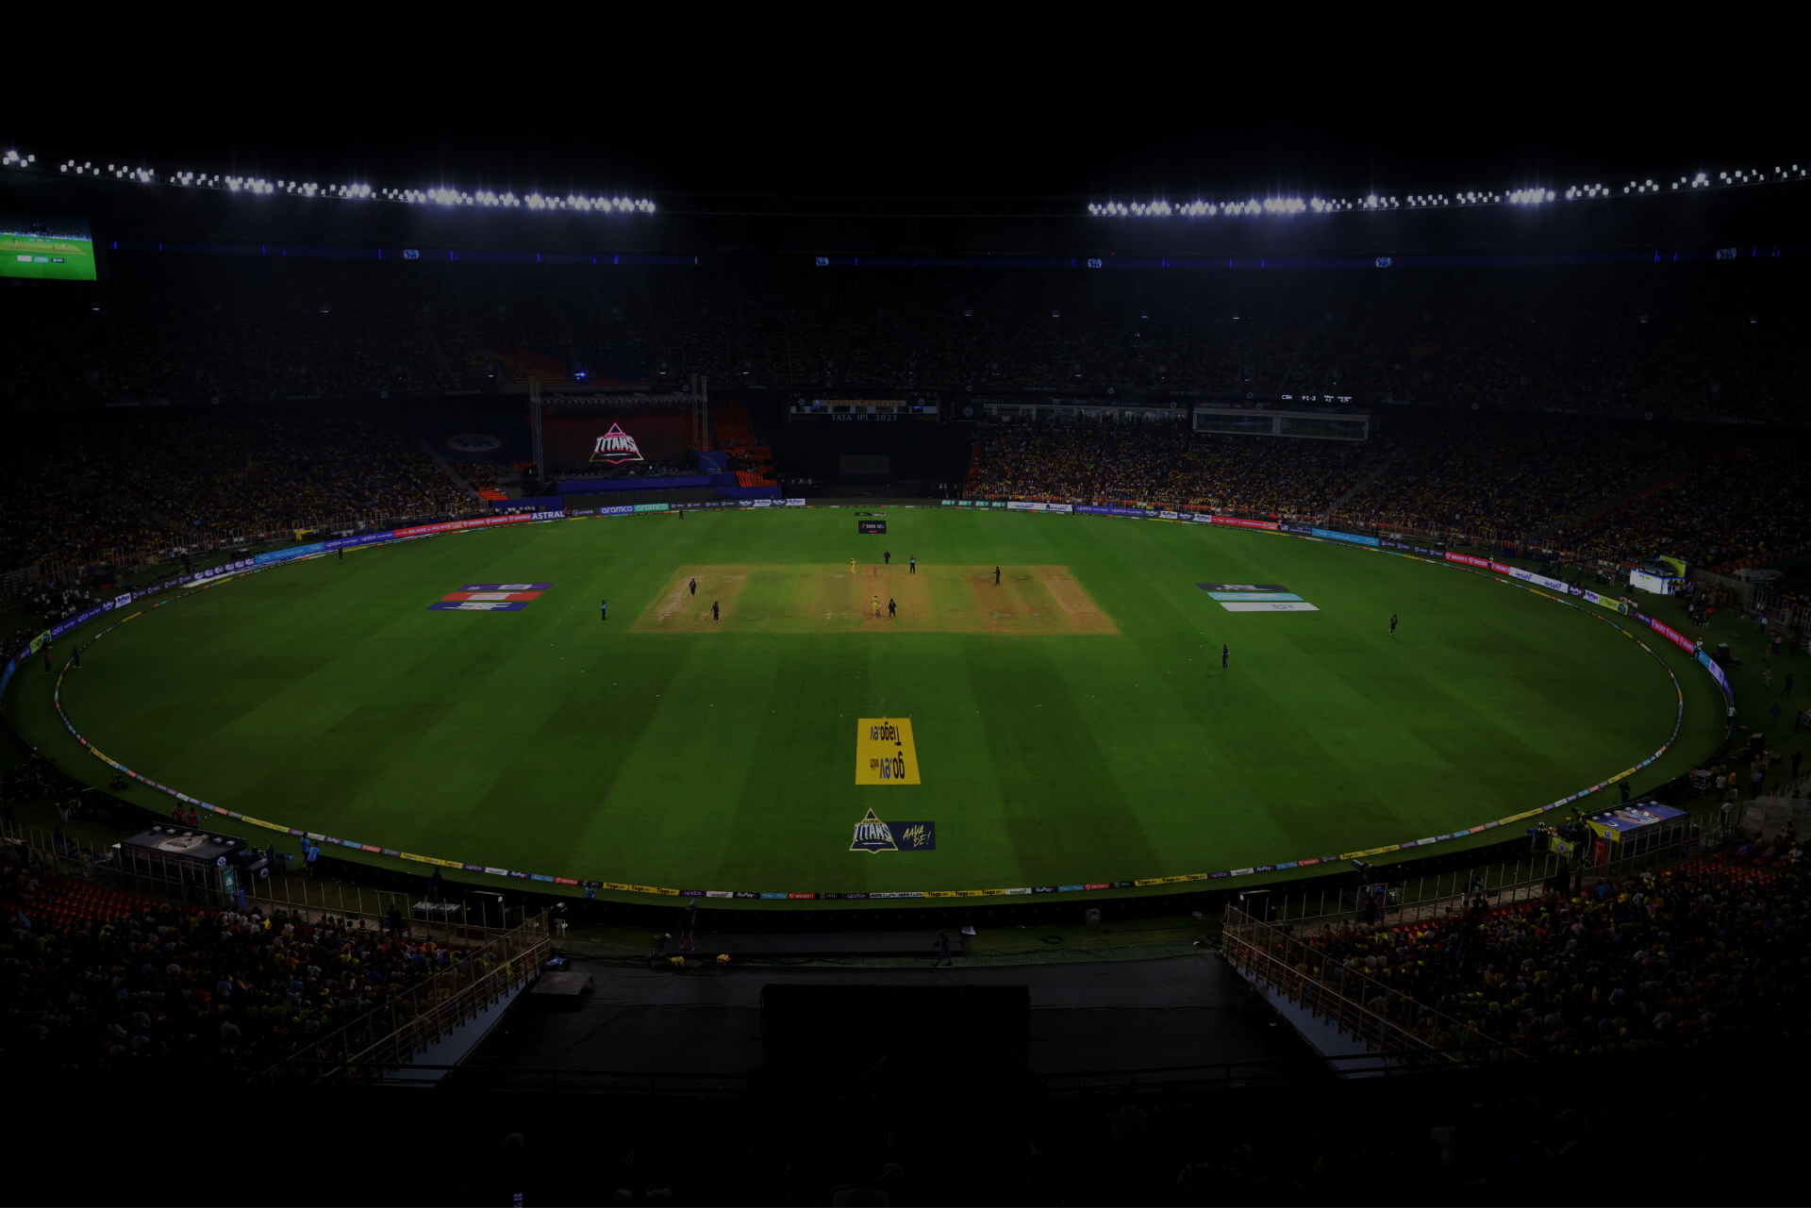








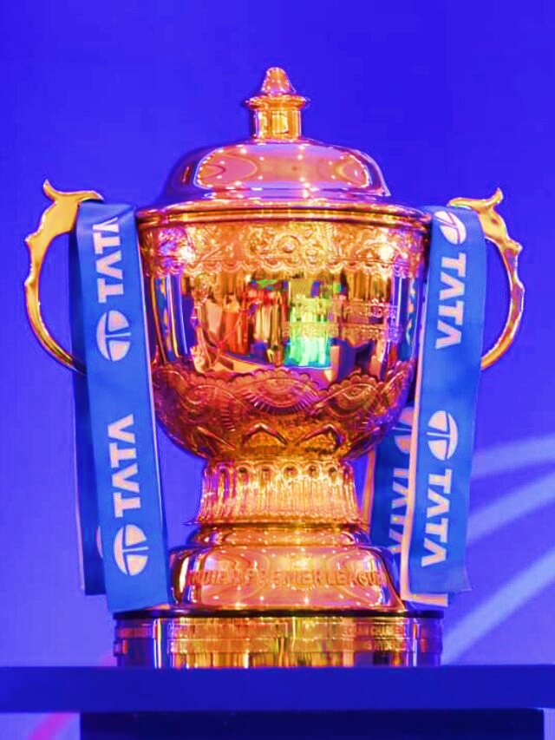






IPL ANALYSIS 2008 - 2017

Slide 2
CONTENTS
Cleaning process involved
Analysis
Visualizations of data
Summary

Slide 3
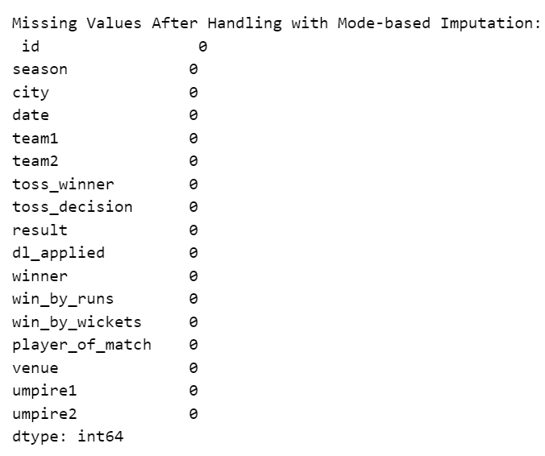
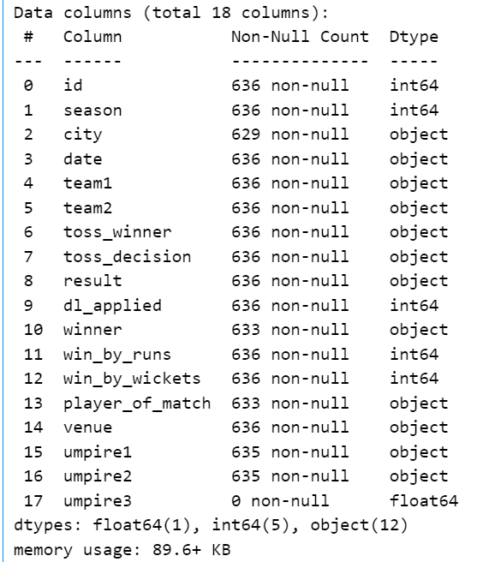
Checking null values

Slide 4
Cleaning Processes:
Rising Pune Supergiant misspelled as Rising Pune Supergiants.
Replaced Null values with Mode values.
Umpire3 column is removed

Slide 5
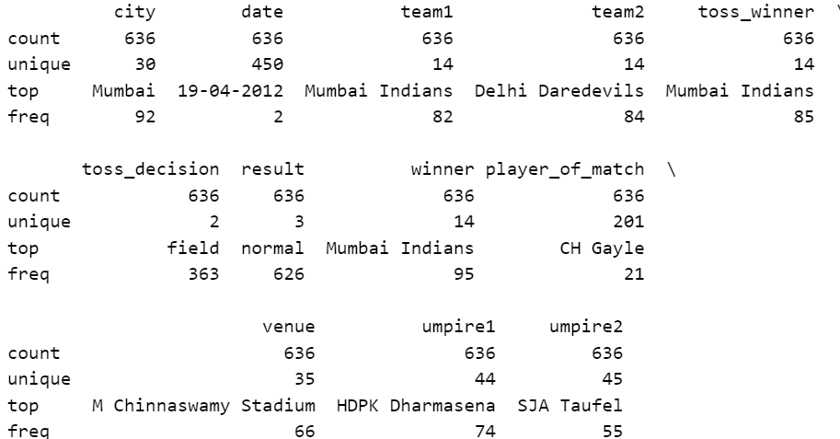
ANALYSIS WITH DESCRIBE FUNCTION FOR CATEGORICAL VARIABLES

Slide 6
Most Frequent Values:
City: Mumbai (92 times) hosted more IPL matches
Toss Decision: Fielding chosen 363 times
Venue: M Chinnaswamy Stadium (66 times)
Umpire1: HDPK Dharmasena (74 times)
Umpire2: SJA Taufel (55 times)
Player of Match: CH Gayle (21 times)

Slide 7
Toss Winning Team

Slide 8
Matches Won

Slide 9
Matches Won by Individual Players

Slide 10
Count of Win by Runs and Wickets

Slide 11
Umpire -1

Slide 12
Umpire -2

Slide 13
Major Toss Decisions

Slide 14
Summary

Slide 15
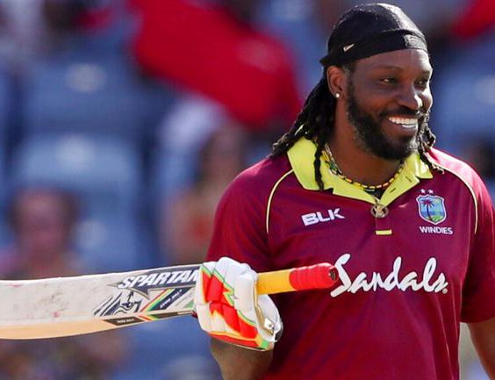
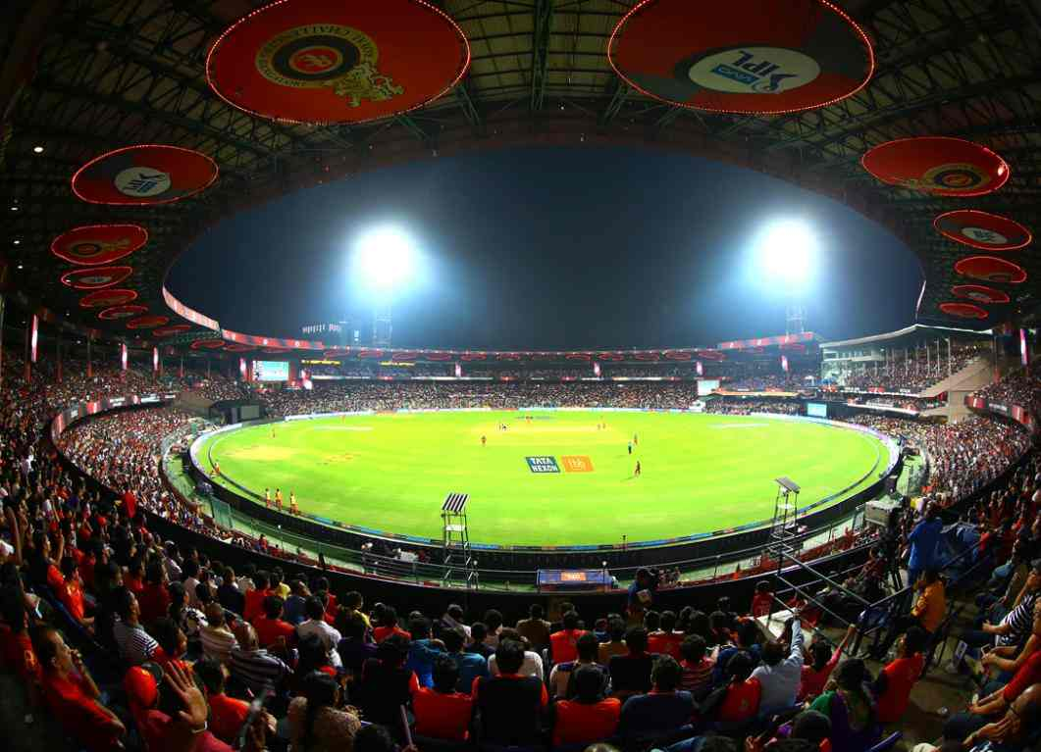
CH Gayle is a standout player with the most player of the match awards.
M Chinnaswamy Stadium is the most frequently used venue.

Slide 16
Mumbai Indians appear prominently as both a team and a toss winner.
The decision to field after winning the toss is more common.

Slide 17
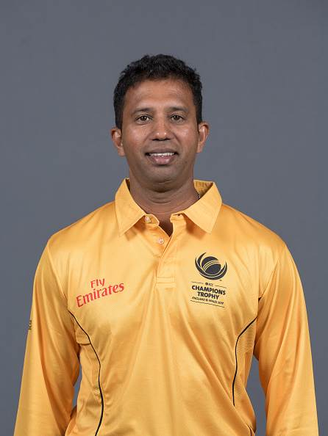
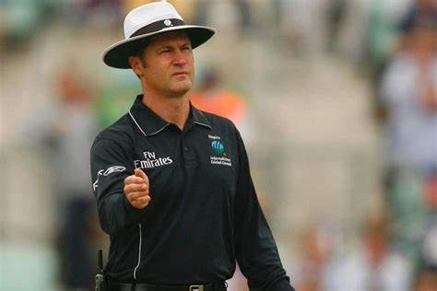
HDPK Dharmasena and SJA Taufel are the most common umpires

Slide 18

THANK YOU
ANALYSIS 2008 - 2017

